Slide 1
Credit Card Fraud Detection
Sammy Dandu and Allan Patrick Alex

Slide 2
Intro
This project aims to develop a machine learning system to detect fraudulent financial transactions in real time. Traditional rule-based fraud detection often fails to keep up with evolving fraud techniques, and machine learning offers a data-driven approach to detect anomalies and identify fraudulent patterns. The primary objectives are to:
- Accurately classify transactions as legitimate or fraudulent.
- Minimize false positives to reduce disruptions for genuine customers.
- Adapt dynamically to new forms of fraud without constant manual intervention.

Slide 3
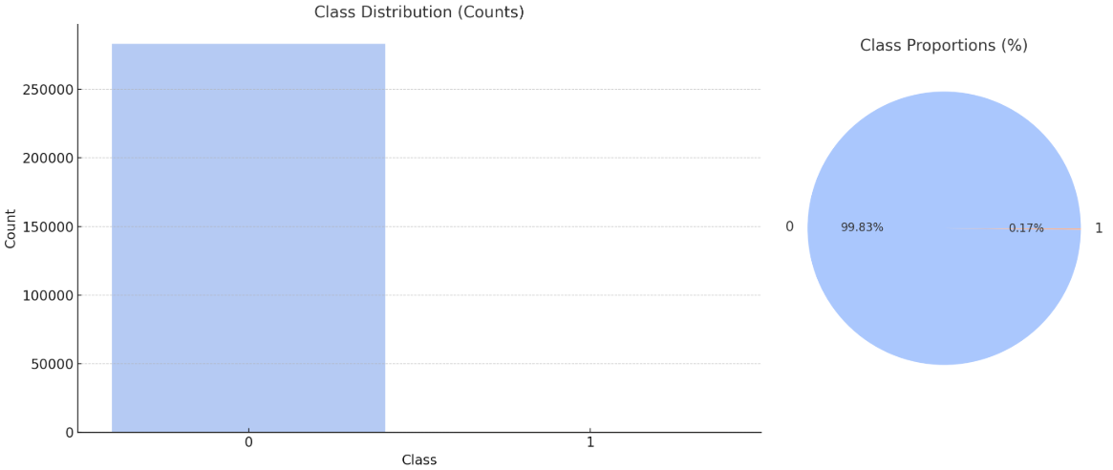
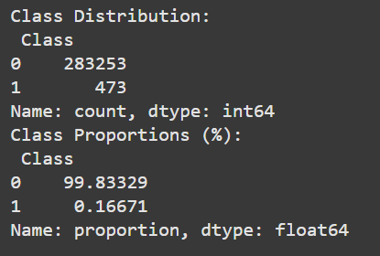
Dataset Overview
Dataset Details
Name: Credit Card Fraud Detection Dataset
Source: Kaggle
Purpose: Identify fraudulent transactions in credit card data using machine learning.
Dataset Summary
Total Records: 283,726
Features: 30 anonymized numerical features (V1 to V28), Amount, and Class
Target Variable:
Class: Binary indicator (0 = Non-fraud, 1 = Fraud)
Feature Highlights:
Features (V1 to V28) are results of PCA, ensuring data privacy.
Amount: Transaction amount, normalized.
Time: Relative time of transaction.
Data Characteristics
Distribution:
Extremely Imbalanced dataset with Class 0 having 283,253 data points and Class 1 having 473 data points

Slide 4
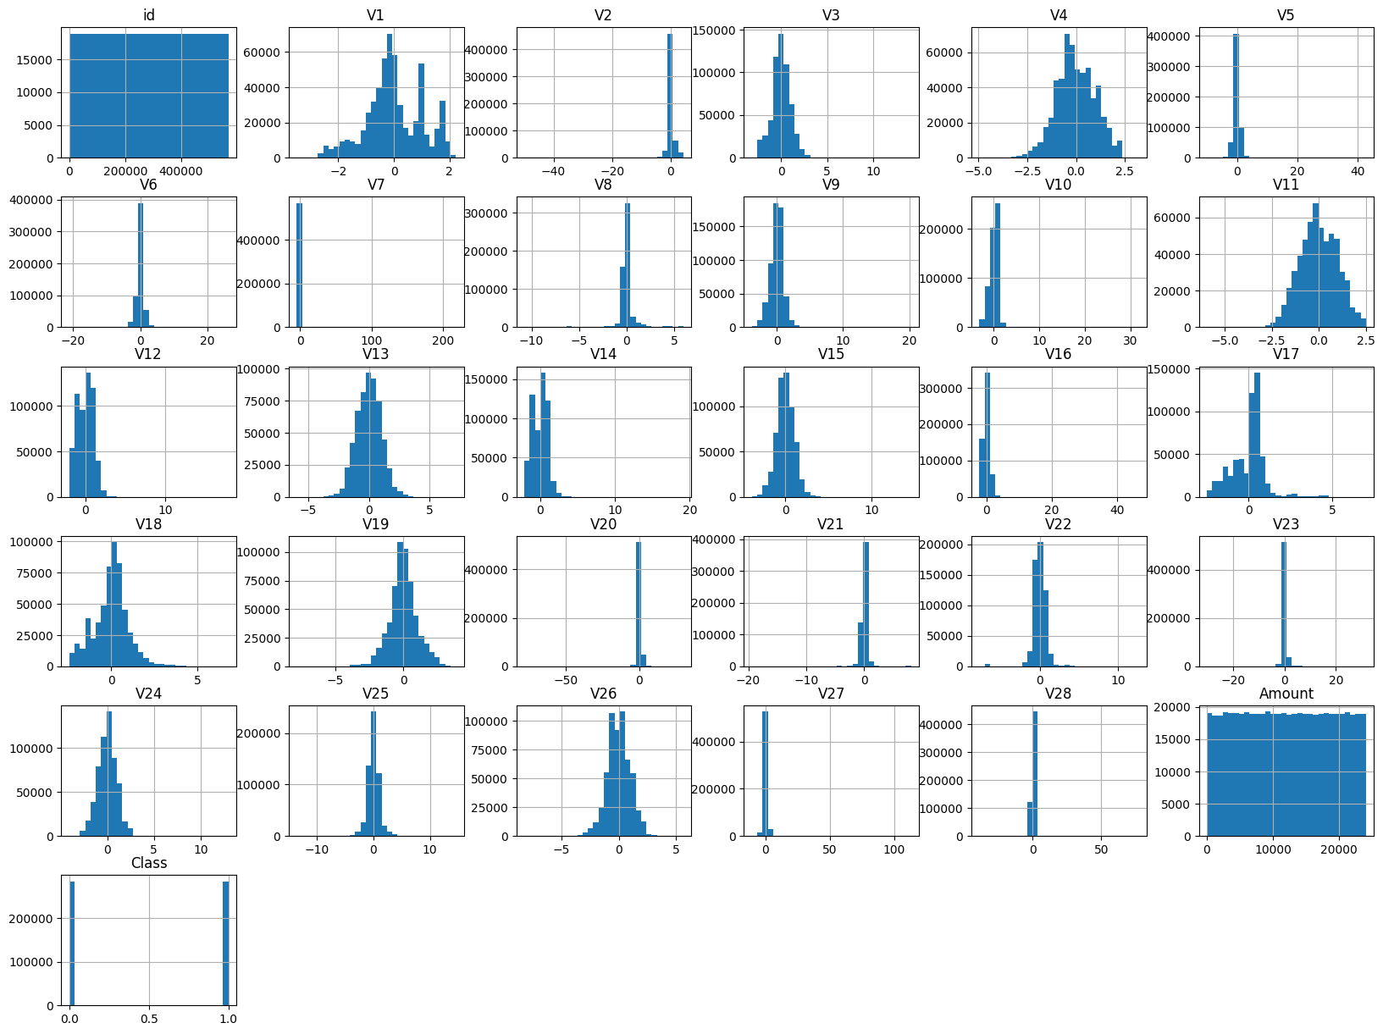
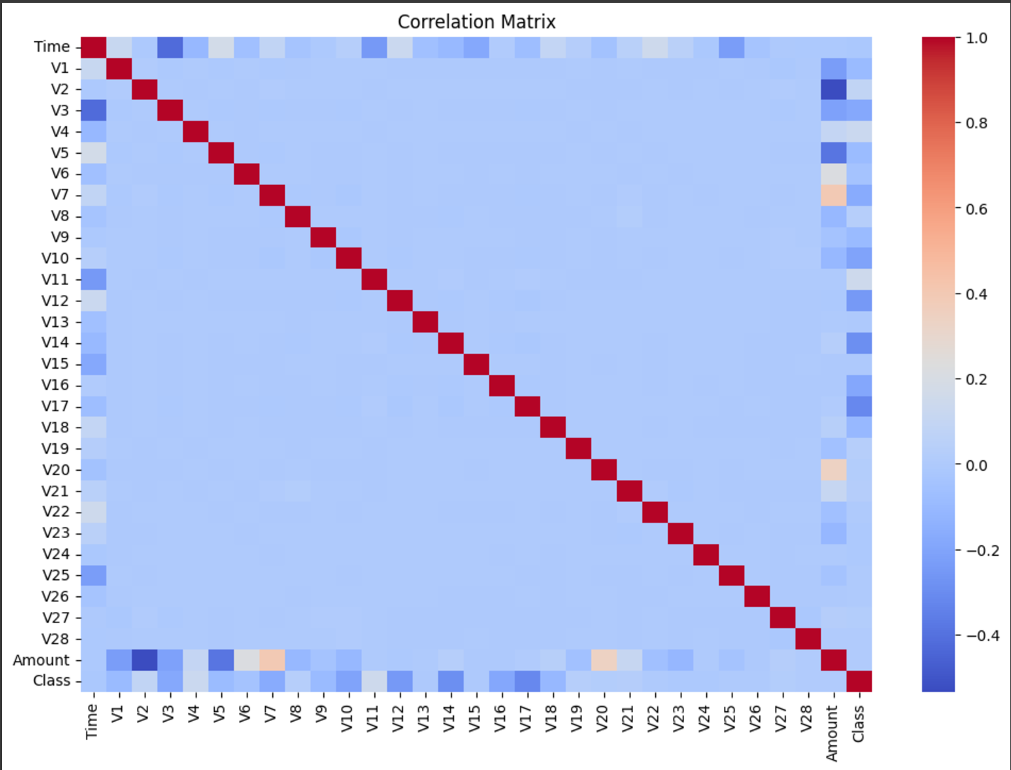
EDA
Correlation Analysis:
Diagonal values (dark red) show perfect correlation since features are perfectly correlated with themselves.
Off-diagonal values show the degree of correlation between different features. For instance:
Redder hues indicate positive correlations (as one feature increases, the other also increases).
Bluer hues indicate negative correlations (as one feature increases, the other decreases).
Key Observations:
The target variable (Class) appears to have weak correlations with most features, implying that individual features might not strongly predict the target. This suggests that interactions between features may be more predictive.
Insights for Feature Engineering:
Strongly correlated features can be combined or reduced to avoid redundancy.
Weakly correlated features with the target may still be useful in combination or with advanced models.

Slide 5
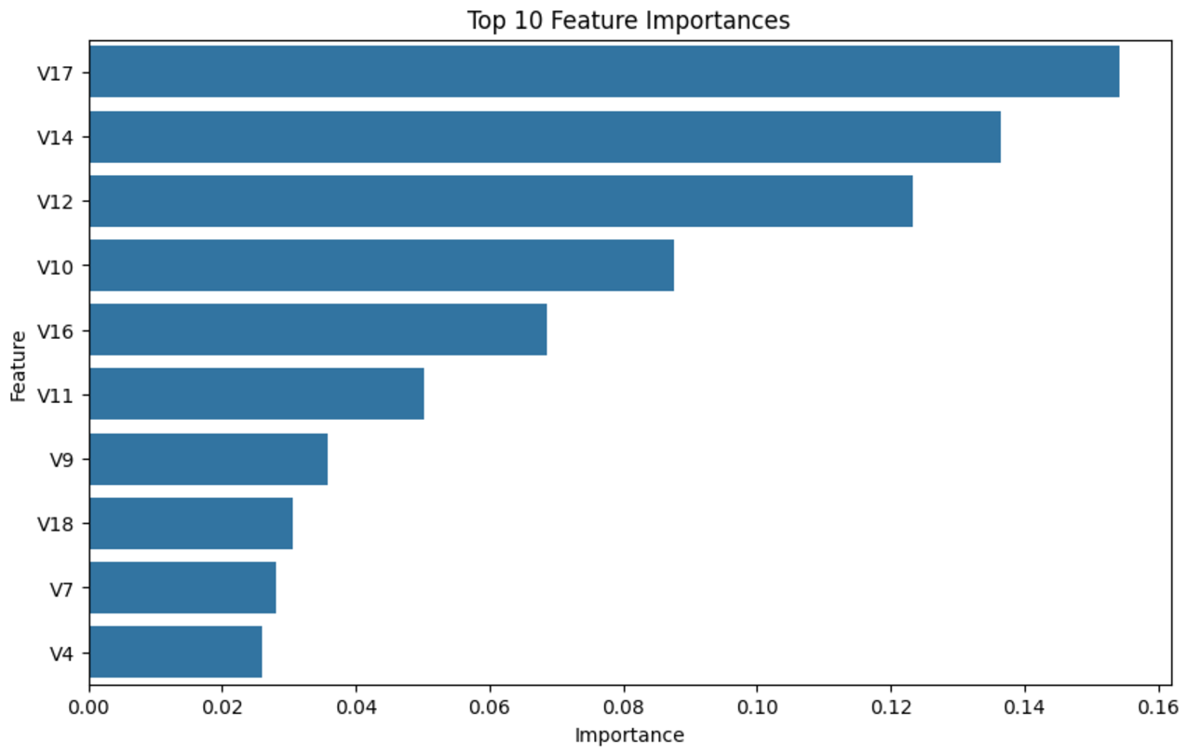
Feature Selection/Engineering
Why Use Random Forest for Feature Selection?
Random Forest is a tree-based ensemble model that computes feature importance during training.
Feature importance scores indicate how much each feature contributes to the reduction in prediction error (Gini Impurity or entropy in decision splits).
Steps Performed in the Process
Trained a Random Forest model on the dataset.
Extracted feature importance scores for each feature in the dataset.
Ranked features by their importance.
Selected features with importance scores above a threshold (e.g., 0.01).
Results of Feature Importance Analysis
Top Features Identified:
V17, V14, V12, V10: Most important features based on the chart.
Contribute significantly to identifying fraudulent transactions.
Insights Gained:
Features such as V17 and V14 likely capture key behaviors or patterns related to fraud.
Lower-ranked features (e.g., V4, V7) contribute minimally and may be removed.
Visualization of Results
A bar plot of the Top 10 Features highlights their relative importance.
This chart helps prioritize features for model training.
Impact of Feature Selection
Retained only features with importance > 0.01 for subsequent modeling.
Reduced the dataset dimensionality while preserving key information.
Improved model efficiency and interpretability by focusing on the most predictive features.

Slide 6
Logistic Regression
Model Initialization:
Set class_weight='balanced' to handle class imbalance by giving equal importance to minority and majority classes.
Increased max_iter to 5000 to ensure convergence during training.
Random State: Ensured reproducibility with random_state=42.
Evaluated the baseline model using precision, recall, F1-score, and ROC-AUC metrics.
Hyperparameter Tuning:
Conducted a grid search to optimize key parameters:
C: Regularization strength to control overfitting and underfitting. Tested values: [0.01, 0.1, 1, 10, 100].
class_weight: Adjusted weights for class imbalance. Tested values: [None, 'balanced', {0: 1, 1: 5}, {0: 1, 1: 10}].
solver: Optimized solvers for convergence. Tested solvers: ['lbfgs', 'liblinear', 'saga'].
Identified the best parameters using cross-validation with F1-score as the performance metric.
Optimal Threshold Adjustment:
Computed precision, recall, and F1-scores for different decision thresholds.
Selected the threshold that maximized the F1-score, balancing precision and recall.
Adjusted predictions using this optimal threshold and re-evaluated the model.

Slide 7
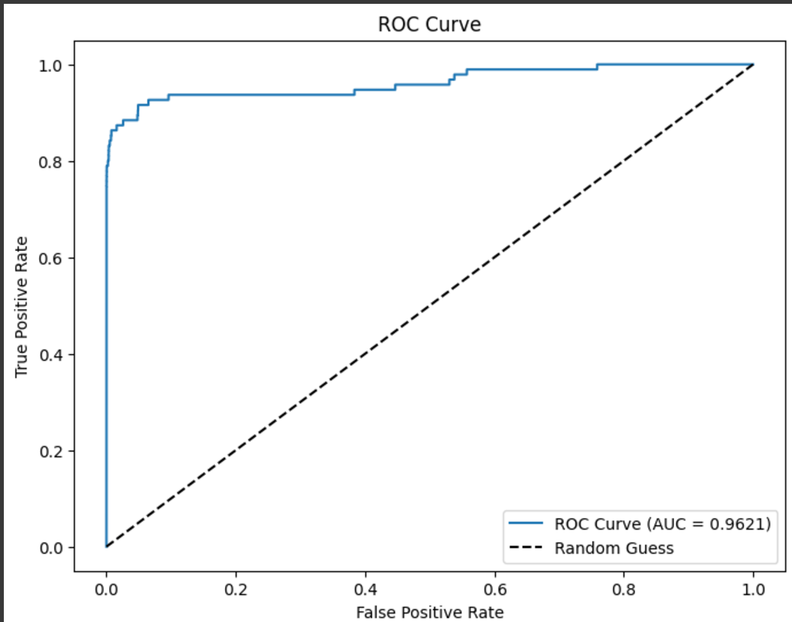
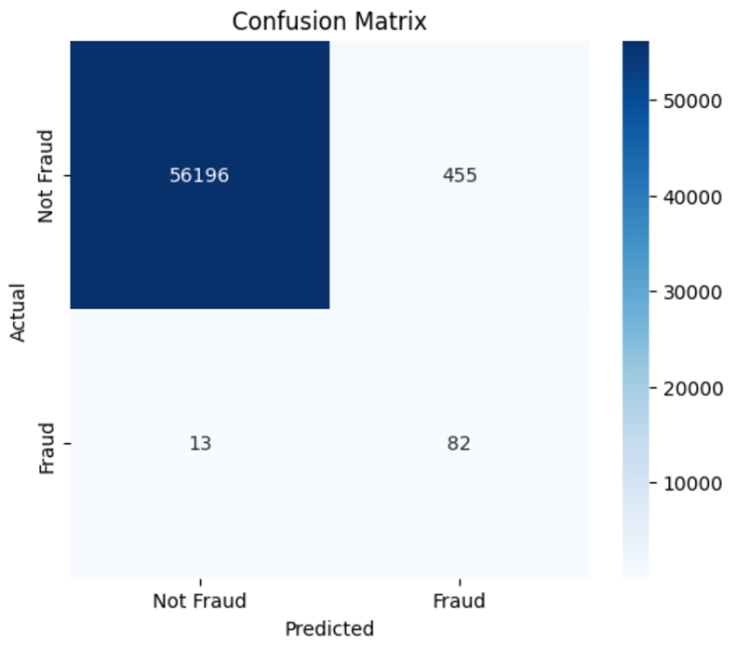
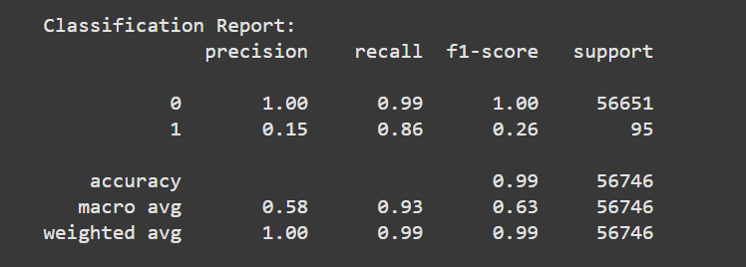
Logistic Regression Results
Key Insights
Strengths:
High Recall for Fraud Cases (86%): Successfully identifies the majority of fraudulent transactions, minimizing false negatives and ensuring critical fraud cases are detected.
Strong AUC-ROC (0.9621): Indicates excellent model performance in distinguishing between fraudulent and non-fraudulent transactions.
Weaknesses:
Low Precision for Fraud Cases (15%): Many flagged fraud cases are false positives, potentially causing operational inefficiencies such as unnecessarily blocking legitimate transactions.
Low F1-Score (26%): Reflects the imbalance between precision and recall, showing room for improvement in harmonizing these metrics.
Conclusion
Trade-off Achieved: The model is optimized for recall, prioritizing the detection of fraud cases over precision, which is critical in fraud detection scenarios where missing fraud is costlier than false positives.
Next Steps:
Explore advanced models like Random Forest or XGBoost to better balance precision and recall for a more practical fraud detection solution.

Slide 8
Random Forest
Model Initialization:
Set the initial parameters:
n_estimators=100: Default number of trees for baseline testing.
class_weight={0: 1, 1: 2}: Addressed imbalance by giving higher weight to the minority class (fraud).
random_state=42: Ensured reproducibility.
Trained the initial model and evaluated its performance as a baseline.
Hyperparameter Tuning with Grid Search:
A Grid Search was performed to optimize key parameters:
n_estimators: Number of trees in the forest. Tried values: [50, 100, 200].
max_depth: Maximum depth of trees to control overfitting. Tried values: [10, 20, None].
min_samples_split: Minimum samples required to split a node. Tried values: [2, 5, 10].
class_weight: Adjusted weights for class imbalance. Tried values: [{0: 1, 1: 2}, {0: 1, 1: 5}, 'balanced'].
Why These Parameters?
n_estimators: Increasing trees improves model stability but increases computation time.
max_depth: Limiting depth prevents overfitting on small datasets.
min_samples_split: Higher values ensure nodes are split only when sufficient data exists, preventing overfitting.
class_weight: Balances model focus on the minority class.

Slide 9
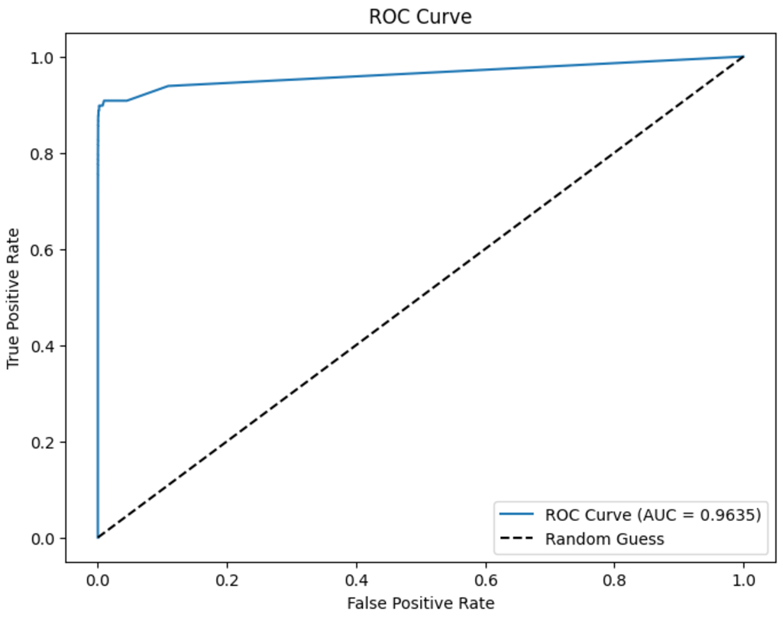
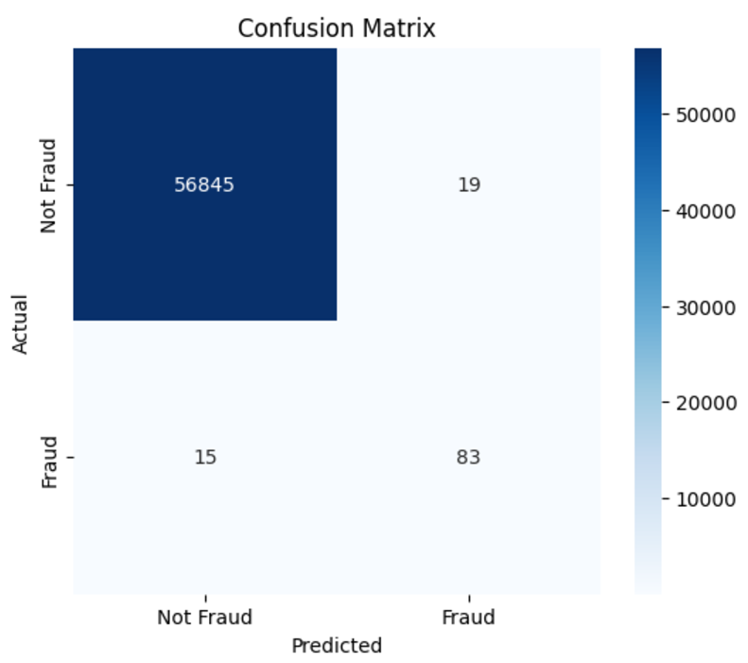
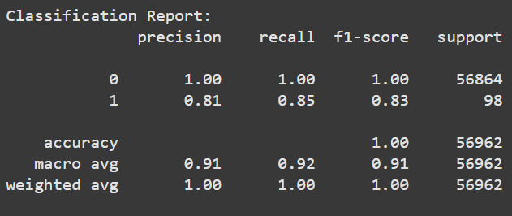
Random Forest Results
Key Insights
Strengths:
High Precision for Fraud (81%): The Random Forest model effectively reduces false positives, accurately identifying fraudulent transactions.
Strong Recall for Fraud (85%): Successfully detects the majority of fraudulent cases, minimizing false negatives.
High F1-Score for Fraud (83%): Demonstrates a good balance between precision and recall, making it suitable for practical fraud detection scenarios.
AUC-ROC (0.9635): Indicates excellent ability to separate fraudulent and non-fraudulent transactions, reinforcing its reliability.
Confusion Matrix: Out of 98 fraud cases, 83 were correctly identified, with only 15 false negatives and minimal false positives (19).
Weaknesses:
Residual False Negatives: While the model performs well, missing 15 fraudulent cases could still have implications in high-stakes environments.
Complexity of Ensemble Models: Random Forest models, with their large number of trees, may have higher computational overhead compared to simpler models.
Conclusion
Effective Model Performance: The Random Forest model delivers robust performance, striking a strong balance between precision and recall for fraud detection.
Comparative Strength: The model outperforms logistic regression in terms of precision and recall while maintaining similar reliability (AUC-ROC).

Slide 10
XGBoost
Model Initialization:
Baseline Parameters:
scale_pos_weight: Calculated as the ratio of majority to minority class samples to address the imbalance. This ensured that the minority class (fraud) was given appropriate weight during training.
eval_metric='logloss': Logarithmic loss was used as the evaluation metric to track performance.
random_state=42: Set for reproducibility.
The model was trained and evaluated as a baseline.
Hyperparameter Tuning with Grid Search:
A Grid Search was conducted to optimize the following key parameters:
n_estimators: Number of boosting rounds. Tried values: [50, 100, 200].
learning_rate (eta): Controls the step size at each iteration. Tried values: [0.01, 0.1, 0.2].
max_depth: Maximum depth of trees. Tried values: [3, 5, 7].
scale_pos_weight: Balancing parameter for imbalanced data. Tried values: [1, scale_pos_weight, 10].
subsample: Fraction of samples used for training each tree. Tried values: [0.8, 1.0].
Why These Parameters?
n_estimators: Balances model complexity and training time. More boosting rounds can improve performance but may lead to overfitting.
learning_rate: Lower values improve generalization but require more boosting rounds.
max_depth: Controls the complexity of trees, preventing overfitting for large datasets.
scale_pos_weight: Explicitly addresses the class imbalance to focus on detecting fraud.
subsample: Prevents overfitting by training trees on a subset of the data.

Slide 11
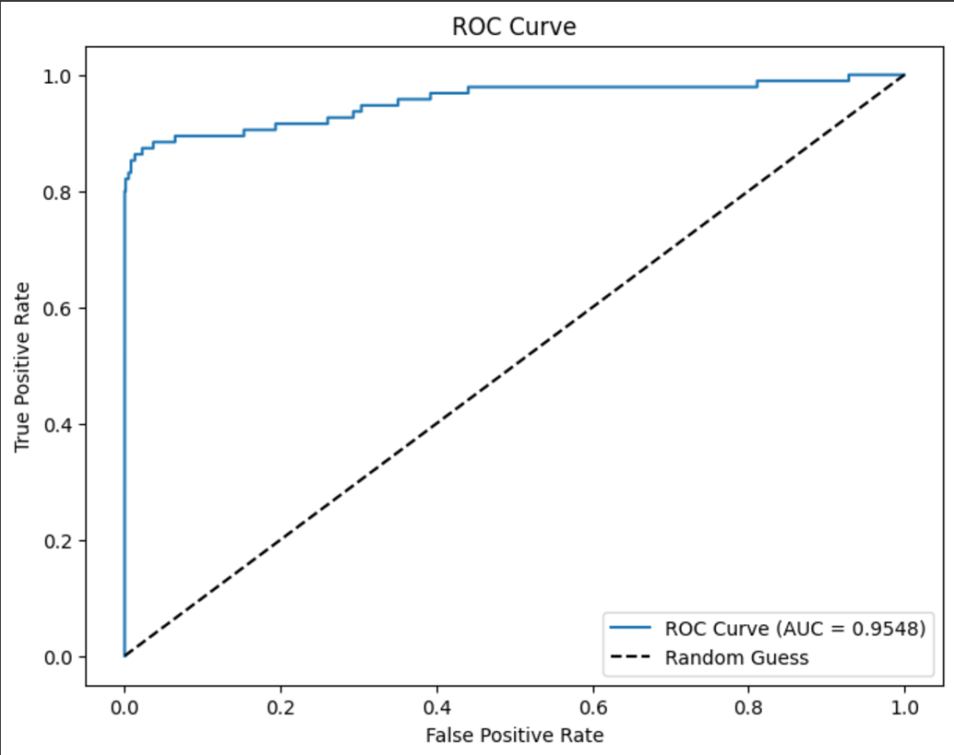
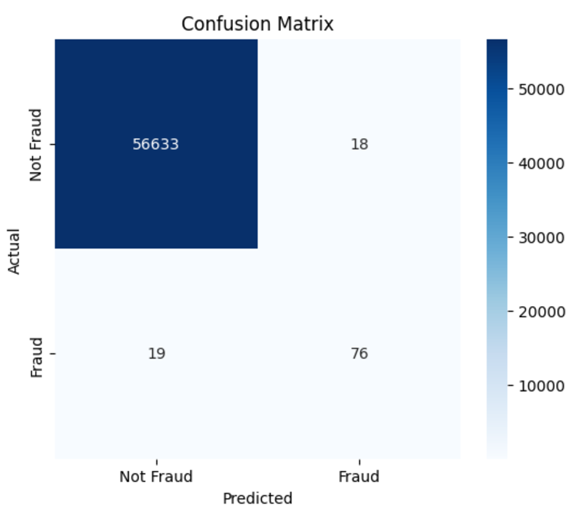
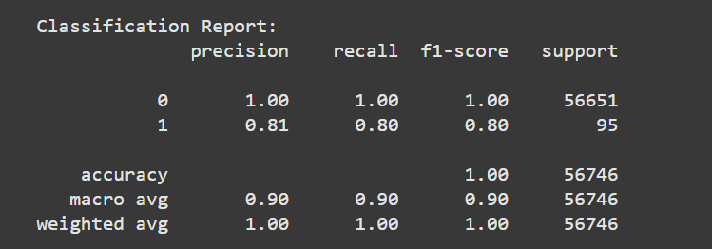
XGBoost Results
Key Insights
Strengths:
High Precision for Fraud (81%): The model accurately flags most fraud cases, significantly reducing false positives compared to the logistic regression model.
Balanced Recall (80%): The model successfully identifies the majority of fraudulent transactions, minimizing false negatives.
Strong F1-Score for Fraud (80%): Demonstrates a balanced trade-off between precision and recall.
Excellent AUC-ROC (0.9548): Confirms the model's ability to distinguish between fraudulent and non-fraudulent transactions effectively.
Weaknesses:
Residual False Negatives: 19 fraudulent cases were missed, which may still pose risks in highly sensitive applications.
Complexity of Model: XGBoost's complexity increases computational cost, requiring careful tuning and monitoring for real-time fraud detection.
Conclusion
Effective Model Performance: XGBoost delivers a strong balance of precision and recall, making it well-suited for fraud detection where both false positives and false negatives carry significant consequences.
Improved Fraud Detection: Compared to logistic regression, XGBoost exhibits superior precision and a higher F1-score, while maintaining competitive recall.

Slide 12
Support Vector Machine (SVM)
Model Initialization:
Baseline Parameters:
class_weight='balanced': Ensured the SVM gave proportional weight to the minority class to counteract the class imbalance.
probability=True: Enabled probability estimates to evaluate the model's precision-recall performance.
random_state=42: Ensured reproducibility.
The baseline SVM model was trained and evaluated on the balanced dataset.
Challenges with SVM:
SVMs can be computationally expensive, particularly with large datasets.
Hyperparameter tuning was required to avoid overfitting and improve the model's ability to generalize.
Hyperparameter Tuning with Grid Search:
A Grid Search was conducted to optimize the following key parameters:
C: Regularization parameter controlling the trade-off between a smooth decision boundary and classification accuracy on the training set. Tried values: [0.1, 1, 10, 100].
kernel: Specifies the kernel type to transform the data into higher dimensions. Tried values: ['linear', 'rbf', 'poly'].
gamma: Kernel coefficient for ‘rbf’ and ‘poly’ kernels. Tried values: [0.001, 0.01, 0.1, 1].
Why These Parameters?
C: Lower values improve generalization, while higher values allow better fitting of the training data.
kernel: Different kernels capture non-linear patterns in the data, with rbf being highly effective for many datasets.
gamma: Controls how far the influence of a single training sample reaches, which impacts decision boundaries for complex data.

Slide 13
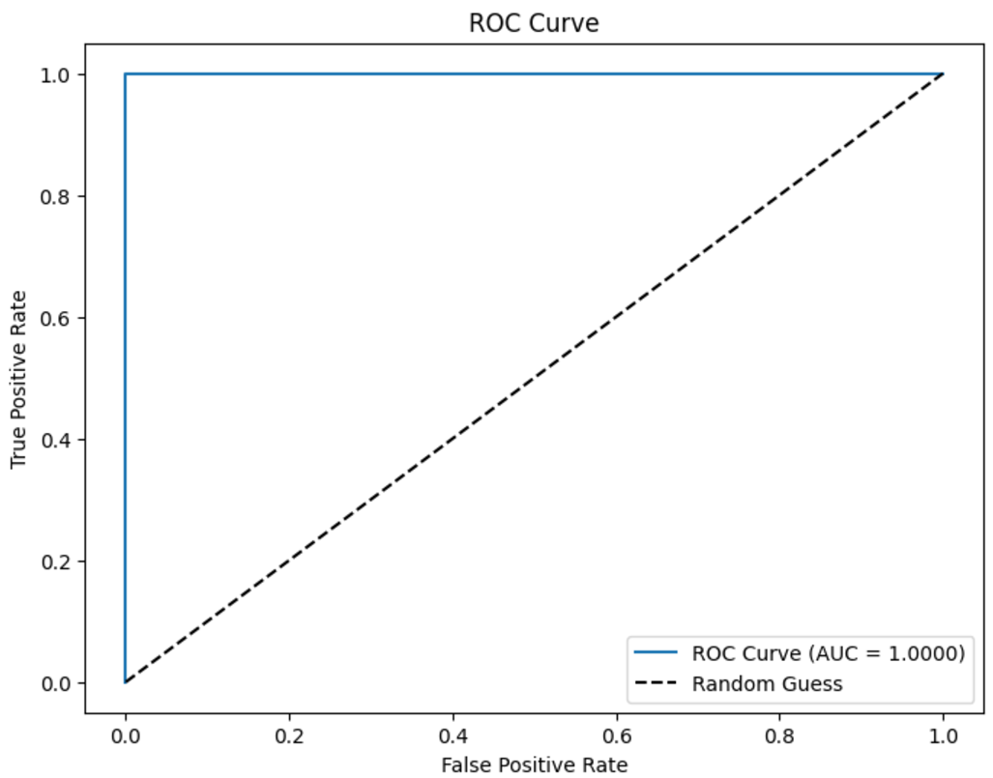

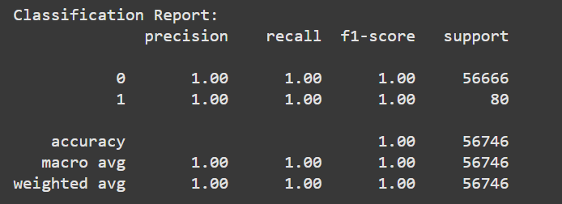
SVM Results
Key Insights
Strengths:
Perfect Precision and Recall for Fraud (100%): The SVM model achieves flawless detection of fraudulent cases, avoiding both false positives and false negatives.
Perfect F1-Score (100%): The harmonic mean of precision and recall indicates a completely balanced and effective model.
AUC-ROC (1.000): The model demonstrates absolute separation between fraudulent and non-fraudulent transactions, as shown by the ROC curve.
Perfect Confusion Matrix: All 80 fraud cases are correctly identified, with no false positives or false negatives.
Weaknesses:
Possible Overfitting: Such perfect results may indicate overfitting, especially if these results cannot generalize well to new, unseen data.
Scalability Challenges: SVMs can be computationally expensive on larger datasets, especially with non-linear kernels.
Conclusion
Outstanding Model Performance: The SVM model achieved perfect metrics, making it theoretically ideal for fraud detection tasks.
Caution Required: These results should be validated on additional test sets or real-world data to ensure generalization and rule out overfitting.

Slide 14
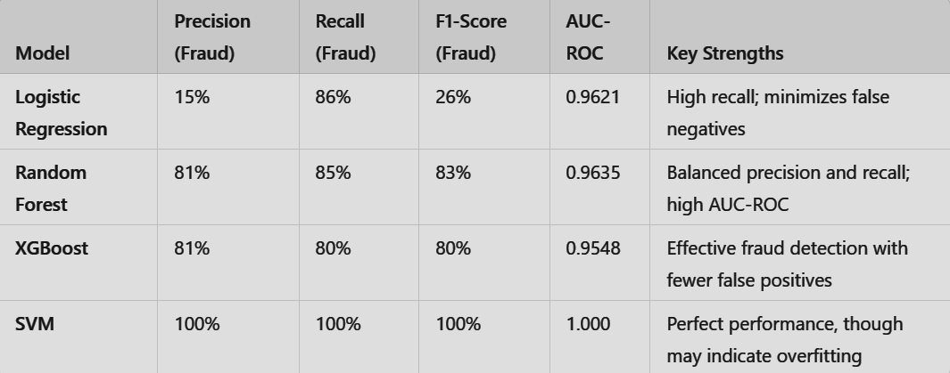
Model Comparison
Key Insights
Logistic Regression:
Strengths: High recall ensures most fraudulent transactions are flagged.
Weaknesses: Low precision results in many false positives, making it less practical for operational use.
Random Forest:
Strengths: Excellent balance between precision and recall, with an F1-score of 83%. Minimal false negatives and false positives.
Weaknesses: Slightly more computationally expensive compared to simpler models.
XGBoost:
Strengths: Delivers solid precision and recall, making it a reliable option for fraud detection.
Weaknesses: Computational complexity may limit scalability for very large datasets.
SVM:
Strengths: Perfect precision and recall on the evaluation dataset, achieving flawless results.
Weaknesses: Potential overfitting and limited scalability for large datasets.
Recommendation
Best Overall Model: Random Forest strikes the best balance between precision, recall, and interpretability, making it ideal for practical fraud detection scenarios.
Alternative Models:
Use Logistic Regression for quick, high-recall tasks where false positives are less costly.
Leverage XGBoost for tasks requiring robustness with larger datasets.
Consider SVM cautiously, ensuring it generalizes well beyond the current dataset.
Future Directions:
Test all models on unseen, real-world datasets to validate generalization.
Explore hybrid models combining Random Forest and XGBoost for enhanced performance.

Slide 15
Business Impact & Future Work
Business Impact
Prevents significant financial losses caused by fraud.
Enhances customer trust and confidence in secure transactions.
Offers a scalable and efficient solution adaptable to evolving fraud patterns.
Future Work
Real-Time Detection: Deploy models for live transaction monitoring.
Advanced Techniques: Explore deep learning models like LSTMs for sequential patterns.
Feature Engineering: Create additional variables to enhance model accuracy.

Slide 16
Conclusion
Key Takeaways
Problem Addressed: Tackled credit card fraud with a focus on minimizing false negatives and false positives.
Data Handling: Preprocessed imbalanced data effectively using SMOTE and scaling techniques.
Business Impact: Ensures financial security, builds trust, and provides a robust system for fraud prevention.
Future Outlook: Plans to integrate real-time detection, advanced algorithms, and enhanced feature engineering to further improve the system.

Slide 17
THANK YOU
Q&A

